Slide 2
Class 20
Serverless

Slide 3
Turn video on, open chat,
greet your colleagues in the chat!
Discussion prompt:
What’s an awesome service
that you use or just like?
(tech, databases, or otherwise)

Slide 4
Logistics
(optional) A5 due tomorrow. Submission link up tonight
Junyoung leads discussion on Tuesday
12/10 In-class Presentations
12/14 Report due

Slide 5
DB seminar talks
9/29 Julia Stoyanovich (NYU)
Responsible Data Management
10/13 Wolfgang Gatterbauer (Northeastern)
QueryVis
10/20 Kostas Karanasos (Microsoft Gray Labs)
Lab overview + In-db ML inference
10/27 Vasiliki Kalavri (Boston U)
Streaming Research
11/10 Aaron Elmore (UChicago)
CrocodileDB
12/9 Cong Yu (Google)
Fact Checking & Structure Data
Zoom link in slack

Slide 6
Each group assigns notetaker
G1: Consider serializable OLTP and how to translate its components to serverless. What translates well, what doesn’t? Are three workarounds?
G2: Consider an OLAP engine (say, snowflake), and how to translate it to serverless functions. Discuss the pros, and technical challenges (and potential workarounds).

Slide 7

Support your colleagues
for speaking up
A quick thanks or follow up
is great

Slide 8
Each group assigns notetaker
G1: Consider serializable OLTP and how to translate its components to serverless. What translates well, what doesn’t? Are three workarounds?
G2: Consider an OLAP engine (say, snowflake), and how to translate it to serverless functions. Discuss the pros, and technical challenges (and potential workarounds).

Slide 9
Class 19
OCC

Slide 10
Turn video on, open chat,
greet your colleagues in the chat!
Discussion prompt:

Slide 11
Logistics
Recitation cancelled (postponed?)
12/10 In-class Presentations
12/14 Report due

Slide 12
DB seminar talks
9/29 Julia Stoyanovich (NYU)
Responsible Data Management
10/13 Wolfgang Gatterbauer (Northeastern)
QueryVis
10/20 Kostas Karanasos (Microsoft Gray Labs)
Lab overview + In-db ML inference
10/27 Vasiliki Kalavri (Boston U)
Streaming Research
11/10 Aaron Elmore (UChicago)
CrocodileDB
12/9 Cong Yu (Google)
Fact Checking & Structure Data
Zoom link in slack

Slide 13
Each group assigns notetaker
G1: OCC’s validation requires checking all xacts between start and finished-tid, which can be slow. How can this O(n) cost be avoided?
G2: Suppose conflicts are rare. What issues might limit OCC’s scalability?

Slide 14

Support your colleagues
for speaking up
A quick thanks or follow up
is great

Slide 15
Each group assigns notetaker
G1: OCC’s validation requires checking all xacts between start and finished-tid, which can be slow. How can this O(n) cost be avoided?
G2: Suppose conflicts are rare. What issues might limit OCC’s scalability?

Slide 16
Class 18
Datalog and Recursive Queries

Slide 17
Turn video on, open chat,
greet your colleagues in the chat!
Discussion prompt:
How much does privacy
affect your choices of services to use?

Slide 18
Logistics
Annotated project drafts sent via slack
Come to office hours to discuss
Next Tuesday’s 11/17 recitation cancelled (postponed?)
12/10 In-class Presentations
12/14 Report due

Slide 19
Each group assigns notetaker
G1: Discuss use cases for lineage. Report details (user, goals, how to use the lineage, and drawbacks) for top 2 use cases.
G2: How could lineage be materialized? Efficiently?

Slide 20
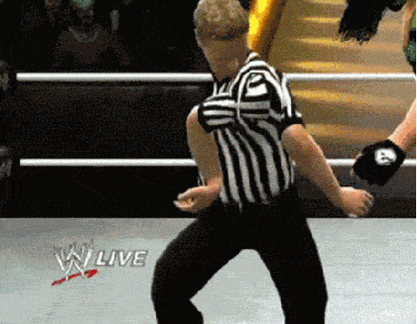
Support your colleagues
for speaking up
A quick thanks or follow up
is great

Slide 21
Each group assigns notetaker
G1: Discuss use cases for lineage. Report details (user, goals, how to use the lineage, and drawbacks) for top 2 use cases.
G2: How could lineage be materialized? Efficiently?

Slide 22
Class 18
Datalog and Recursive Queries

Slide 23
Turn video on, open chat,
greet your colleagues in the chat!
Discussion prompt:
Choose your own topic!

Slide 24
Logistics
Optional A5 is out (lineage)
Optional datalog “assignment”
Paper reviews are released
Come to recitation/office hours to discuss, or ask on Slack

Slide 25
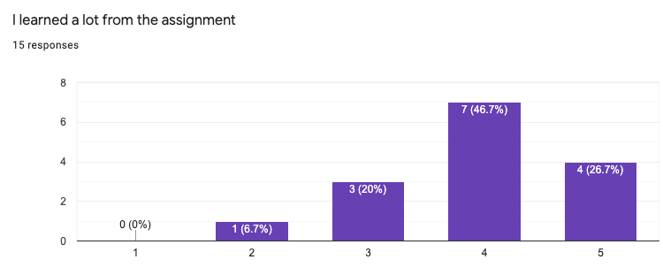
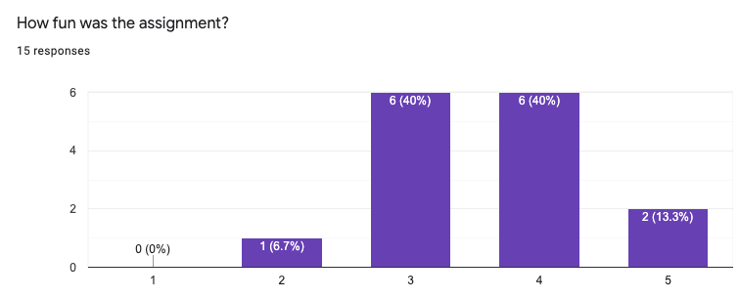

Slide 26
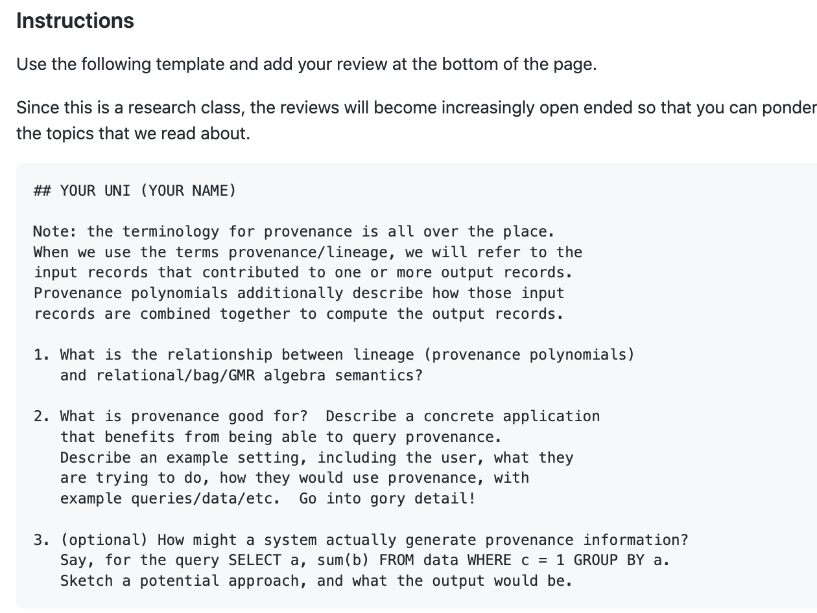
Reviews

Slide 27
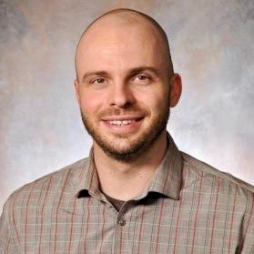
DB seminar talks
9/29 Julia Stoyanovich (NYU)
Responsible Data Management
10/13 Wolfgang Gatterbauer (Northeastern)
QueryVis
10/20 Kostas Karanasos (Microsoft Gray Labs)
Lab overview + In-db ML inference
10/27 Vasiliki Kalavri (Boston U)
Streaming Research
11/10 Aaron Elmore (UChicago)
CrocodileDB
12/? Cong Yu (Google)
Fact Checking & Structure Data
Zoom link in slack

Slide 28
Each group assigns notetaker
G1: What are some potentially impactful use cases for datalog as compared to SQL? Report the top 2.
G2: Datalog is equivalent to first order logic. What makes negation and general expressions challenging? Report 1 example.
G3: A4 was about hypothesis-driven experiment design. Discuss what you did in A4 and what you learned. Report the top 2 suggestions for exp design.

Slide 29

Support your colleagues
for speaking up
A quick thanks or follow up
is great

Slide 30
Each group assigns notetaker
G1: What are some potentially impactful use cases for datalog as compared to SQL? Report the top 2.
G2: Datalog is equivalent to first order logic. What makes negation and general expressions challenging? Report 1 example.
G3: A4 was about hypothesis-driven experiment design. Discuss what you did in A4 and what you learned. Report the top 2 suggestions for exp design.

Slide 31
Class 17
Datalog and Recursive Queries

Slide 32
Turn video on, open chat,
greet your colleagues in the chat!
Discussion prompt:
Where do you usually get your news?

Slide 33
Logistics
PC reviews due tomorrow
A4 due tomorrow

Slide 34
DB seminar talks
9/29 Julia Stoyanovich (NYU)
Responsible Data Management
10/13 Wolfgang Gatterbauer (Northeastern)
QueryVis
10/20 Kostas Karanasos (Microsoft Gray Labs)
Lab overview + In-db ML inference
10/27 Vasiliki Kalavri (Boston U)
Streaming Research
11/10 Aaron Elmore (UChicago)
CrocodileDB
12/? Cong Yu (Google)
Fact Checking & Structure Data
Zoom link in slack

Slide 35
Each group assigns notetaker
Discuss tips for reading papers & writing good reviews
Each group shares 2 tips with the class

Slide 36

Support your colleagues
for speaking up
A quick thanks or follow up
is great

Slide 37
Each group assigns notetaker
Discuss tips for reading papers & writing good reviews
Each group shares 2 tips with the class

Slide 38
Class 16
Inc Mat Views

Slide 39
Turn video on, open chat,
greet your colleagues in the chat!
Discussion prompt:
Discuss Tuesday’s lecture

Slide 40
Logistics
Paper draft due TODAY
https://easychair.org/conferences/?conf=w611320
No class on election day
Next 2 reviews will be dedicated to your assigned PC papers
Assignments out tomorrow

Slide 41
DB seminar talks
9/29 Julia Stoyanovich (NYU)
Responsible Data Management
10/13 Wolfgang Gatterbauer (Northeastern)
QueryVis
10/20 Kostas Karanasos (Microsoft Gray Labs)
Lab overview + In-db ML inference
10/27 Vasiliki Kalavri (Boston U)
Streaming Research
11/10 Aaron Elmore (UChicago)
CrocodileDB
12/? Cong Yu (Google)
Fact Checking & Structure Data
Zoom link in slack

Slide 42
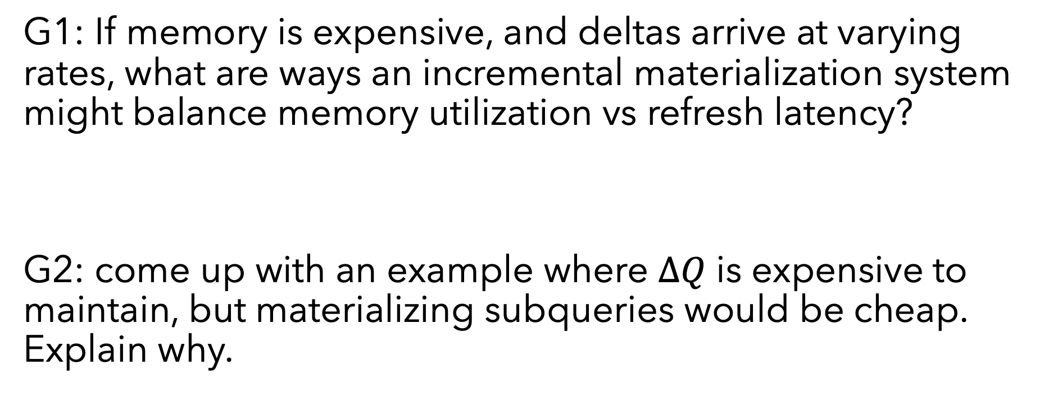
Each group assigns notetaker
G1: If memory is expensive, and deltas arrive at varying rates, what are ways an incremental materialization system might balance memory utilization vs refresh latency?
G2: come up with an example where $ΔQ$ is expensive to maintain, but materializing subqueries would be cheap. Explain why.

Slide 43

Support your colleagues
for speaking up
A quick thanks or follow up
is great
https://www.dreamstime.com/photos-images/dog-thumbs-up.html

Slide 44
Each group assigns notetaker
G1: If memory is expensive, and deltas arrive at varying rates, what are ways an incremental materialization system might balance memory utilization vs refresh latency?
G2: come up with an example where $ΔQ$ is expensive to maintain, but materializing subqueries would be cheap. Explain why.

Slide 45
Class 14
Materialized Views

Slide 46
Turn video on, open chat,
greet your colleagues in the chat!
Discussion prompt:
Have you watched the social dilemma?

Slide 47
Logistics
A3 deadline has passed. 5 grace days in effect
Paper draft 10/29
https://easychair.org/conferences/?conf=w611320
Invites emailed to serve on the program committee

Slide 48
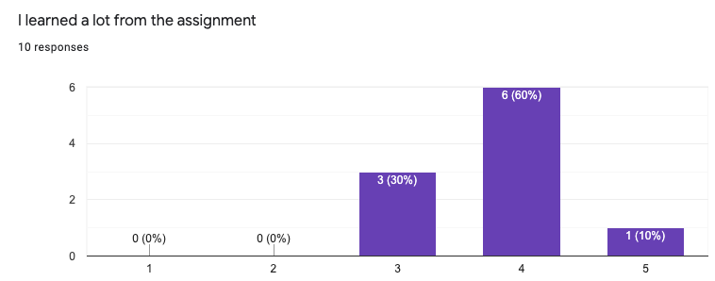
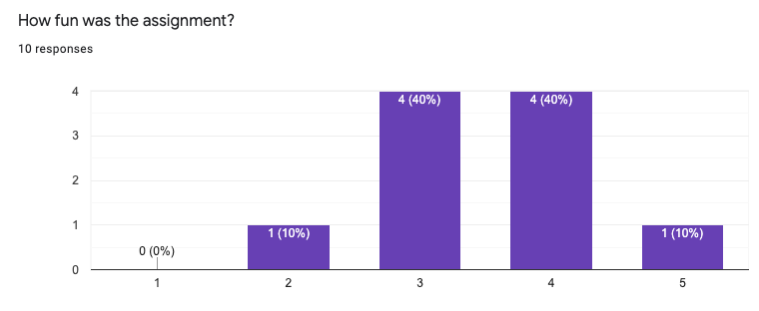
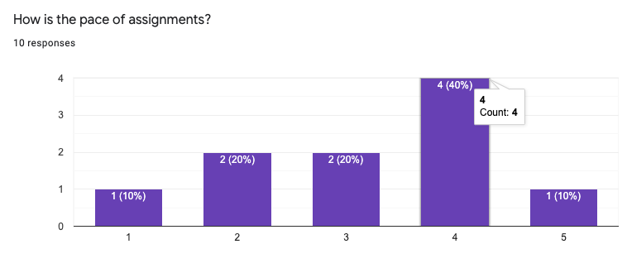

Slide 49
DB seminar talks
Vasiliki’s talk is 4-5:30PM!
Replaces Tuesday Class
9/29 Julia Stoyanovich (NYU)
Responsible Data Management
10/13 Wolfgang Gatterbauer (Northeastern)
QueryVis
10/20 Kostas Karanasos (Microsoft Gray Labs)
Lab overview + In-db ML inference
10/27 Vasiliki Kalavri (Boston U)
Streaming Research
11/10 Aaron Elmore (UChicago)
CrocodileDB
Zoom link in slack

Slide 50
Each group assigns notetaker
Discuss a non-database use case
that could be viewed from a
materialized view perspective
(systems, hardware, government, real-life, etc)
Explore the implications

Slide 51

SPEAKS UP
THUMB UP
Support your colleagues
for speaking up
A quick thanks or follow up
is great

Slide 52
Each group assigns notetaker
Discuss a non-database use case
that could be viewed from a
materialized view perspective
(systems, hardware, government, real-life, etc)
Explore the implications!

Slide 53
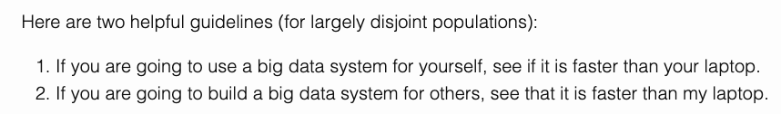
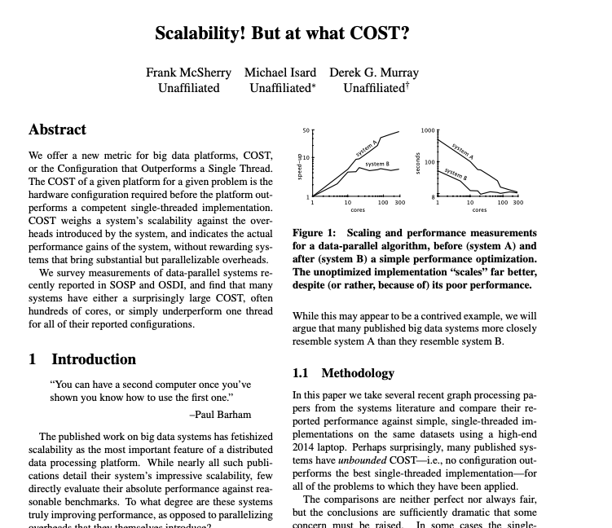

Slide 54
Class 13
Incremental Dataflow

Slide 55
Turn video on, open chat,
greet your colleagues in the chat!
Discussion prompt:
Favorite music artist/band!
Is this a sandwich?

Slide 56
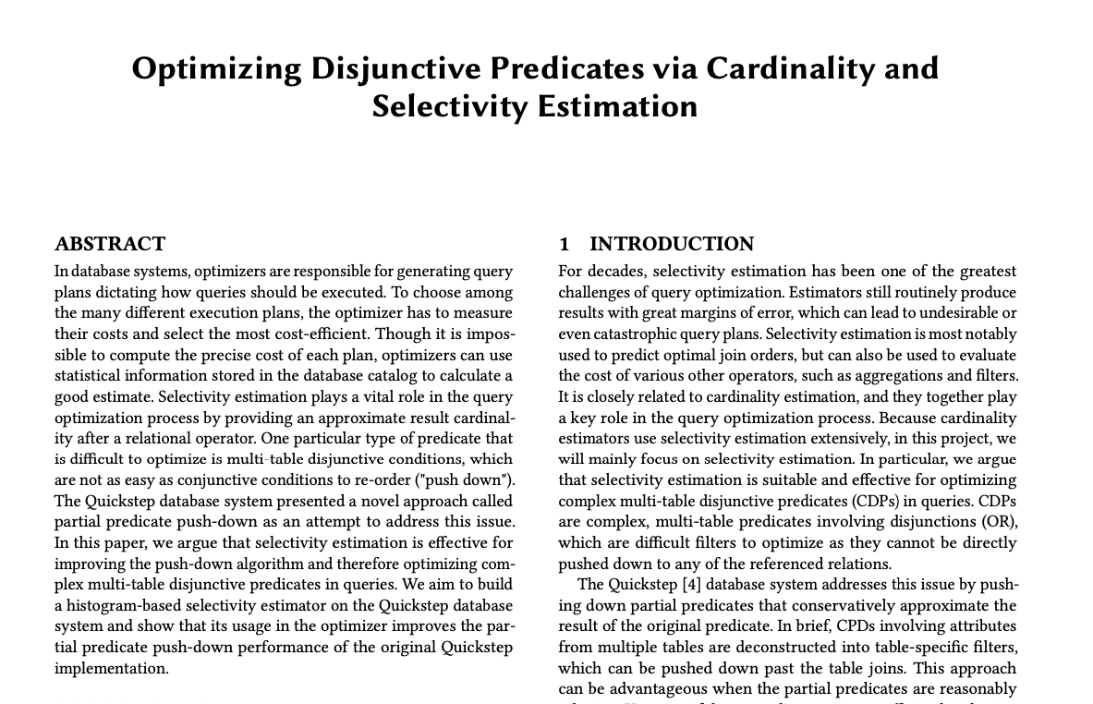
Logistics
A3 due 10/21
A4 out: hypothesis-driven experiment design
Paper draft 10/29
https://easychair.org/conferences/?conf=w611320
Invites emailed to serve on the program committee
Example draft submission from 2019 w6113

Slide 57
Draft: Reproduce and Extend
Introduction
The motivation for what you will reproduce.
Clear reason for why the system you will implement within is appropriate.
Technical Approach
Detailed description of algorithms you will reproduce, and specifically how they will be implemented
Experiments
List the hypothesis, baselines experiment designs
OK to not have run experiments

Slide 58
Draft: Research Project
Introduction
The argument flow from problem to your novelty should be clear
Technical Approach
Describe a naïve version of your solution highlights the ideas (but may be inefficient/unoptimized)
Experiments
List the hypothesis, baselines experiment designs
OK to not have run experiments
Related Work
Define dimensions that distinguish your work from prior works
Timely Dataflow defines similar categories:
Acyclic batch data flow
Incremental computation
Stream processing systems
Cyclic dataflows
See How to Architect a Query Complier, Revisited for a strong related works section

Slide 59
DB seminar talks
9/29 Julia Stoyanovich (NYU)
Responsible Data Management
10/13 Wolfgang Gatterbauer (Northeastern)
QueryVis
10/20 Kostas Karanasos (Microsoft Gray Labs)
Lab overview + In-db ML inference
10/27 Vasiliki Kalavri (Boston U)
Streaming Research
11/10 Aaron Elmore (UChicago)
CrocodileDB
TODAY
Zoom link in slack

Slide 60
Each group assigns notetaker
G1: Suppose data arrives in timestamp order, and the dataflow groups by timestamp. What drawbacks would Naiad exhibit compared to batch systems? How could they be addressed?
G2: To what extent could a batch system (e.g., Spark, Cloud DB) be adopted to support Naiad’s ideas? Try to sketch a solution
G3: Let’s say you built a SQL engine on top of Naiad. What properties would the engine have beyond a typical SQL engine?

Slide 61

Support your colleagues
for speaking up
A quick thanks or follow up
is great
2 Thumbs 4 SPEAKING UP
https://thumbsandammo.blogspot.com/

Slide 62
Each group assigns notetaker
G1: Suppose data arrives in timestamp order, and the dataflow groups by timestamp. What drawbacks would Naiad exhibit compared to batch systems? How could they be addressed?
G2: To what extent could a batch system (e.g., Spark, Cloud DB) be adopted to support Naiad’s ideas? Try to sketch a solution
G3: Let’s say you built a SQL engine on top of Naiad. What properties would the engine have beyond a typical SQL engine?

Slide 64
Class 12
Batch Dataflow

Slide 65
Turn video on, open chat,
greet your colleagues in the chat!
Warmup discussion:
What would be a good warmup discussion
for next class?

Slide 66
Logistics
A3 due 10/21
Paper draft: 11/29. Submit through conf review site

Slide 67
DB seminar talks
9/29 Julia Stoyanovich (NYU)
Responsible Data Management
10/13 Wolfgang Gatterbauer (Northeastern)
QueryVis
10/20 Kostas Karanasos (Microsoft Gray Labs)
Lab overview + In-db ML inference
10/27 Vasiliki Kalavri (Boston U)
Streaming Research
11/10 Aaron Elmore (UChicago)
CrocodileDB
Zoom link in slack

Slide 68
Each group assigns notetaker
G1: Compare MR and RDD’s fault tolerance approaches (assumptions, where information is managed, etc)
G2: Compare the different “big data” systems we’ve read so far: Dremel/Snowflake, Spark, MR, Parallel DBs. What dimensions matter?
G3: Translate the concepts in RDDs into database terminology.

Slide 69

Support your colleagues
for speaking up
A quick thanks or follow up
is great
SPEAKING UP
https://thumbsandammo.blogspot.com/

Slide 70
Each group assigns notetaker
G1: Compare MR and RDD’s fault tolerance approaches (assumptions, where information is managed, etc)
G2: Compare the different “big data” systems we’ve read so far: Dremel/Snowflake, Spark, MR, Parallel DBs. What dimensions matter?
G3: Translate the concepts in RDDs into database terminology.

Slide 71
Class 11
UDFs

Slide 72
Turn video on, open chat,
greet your colleagues in the chat!
Warmup discussion:
What shows are you watching these days?

Slide 73
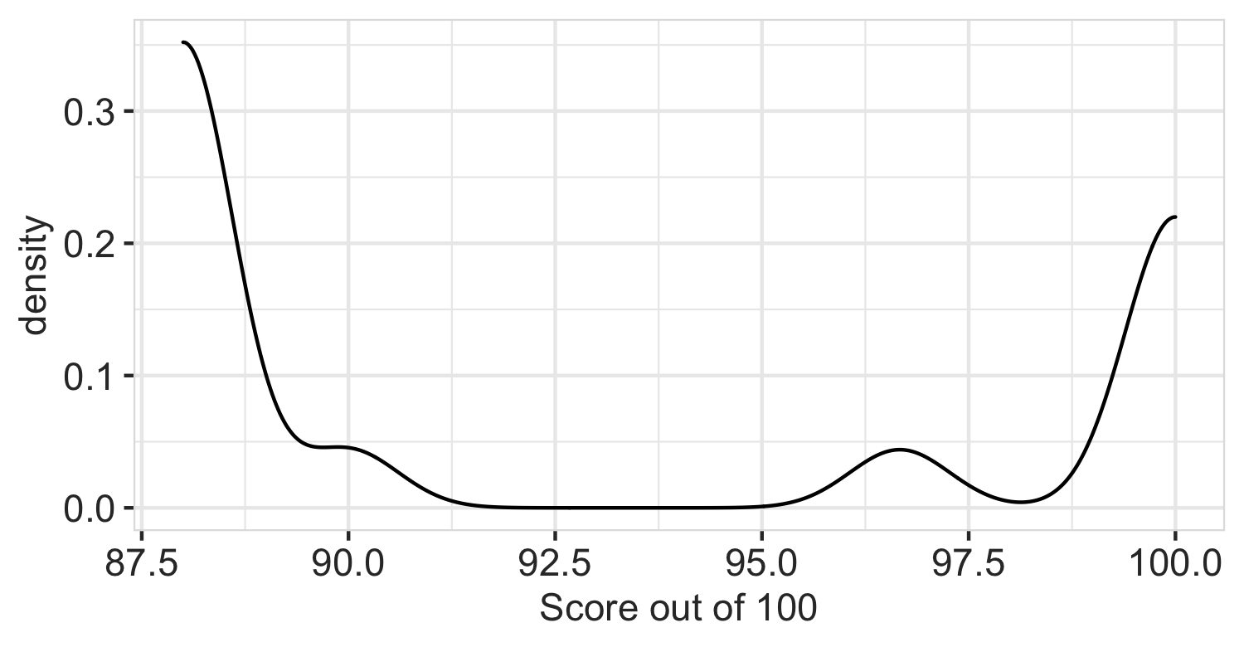
Logistics
A2 graded, reference code is out
A3 due 10/21
Paper draft: 11/29

Slide 74
DB seminar talks
TODAY
9/29 Julia Stoyanovich (NYU)
Responsible Data Management
10/13 Wolfgang Gatterbauer (Northeastern)
QueryVis
10/20 Kostas Karanasos (Microsoft Gray Labs)
Lab overview + In-db ML inference
10/27 Vasiliki Kalavri (Boston U)
Streaming Research
11/10 Aaron Elmore (UChicago)
CrocodileDB
Zoom link in slack

Slide 75
Each group assigns notetaker
G1: Come up with some killer use cases for UDFs. (Combined with user defined types, UDFs are very powerful!)
G2: WHEN and HOW do UDFs pose a problem for query optimization and execution?
G3: Beyond caching, what other tricks might accelerate queries that use UDFs

Slide 76

Support your colleagues
for speaking up
A quick thanks or follow up
is great
https://en.wikipedia.org/wiki/Thumb_signal

Slide 77
Each group assigns notetaker
G1: Come up with some killer use cases for UDFs. (Combined with user defined types, UDFs are very powerful!)
G2: WHEN and HOW do UDFs pose a problem for query optimization and execution?
G3: Beyond caching, what other tricks might accelerate queries that use UDFs

Slide 78
Class 10
Query Compilation

Slide 79
Turn video on, open chat,
greet your colleagues in the chat!
Warmup discussion:
What are some types of disaggregation in your daily life?
When is it sensible to disaggregate vs consolidate?

Slide 80
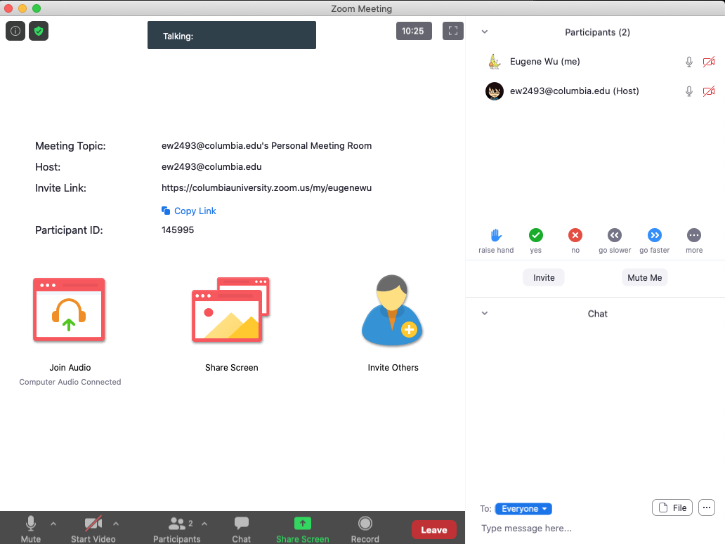
Logistics
Thanks for the bug reports!
Vote: Share and review paper drafts (due 10-22)?

Slide 81
DB seminar talks
9/29 Julia Stoyanovich (NYU)
Responsible Data Management
10/13 Wolfgang Gatterbauer (Northeastern)
QueryVis
10/20 Kostas Karanasos (Microsoft Gray Labs)
Lab overview + In-db ML inference
10/27 Vasiliki Kalavri (Boston U)
Streaming Research
11/10 Aaron Elmore (UChicago)
CrocodileDB
Zoom link in slack

Slide 82
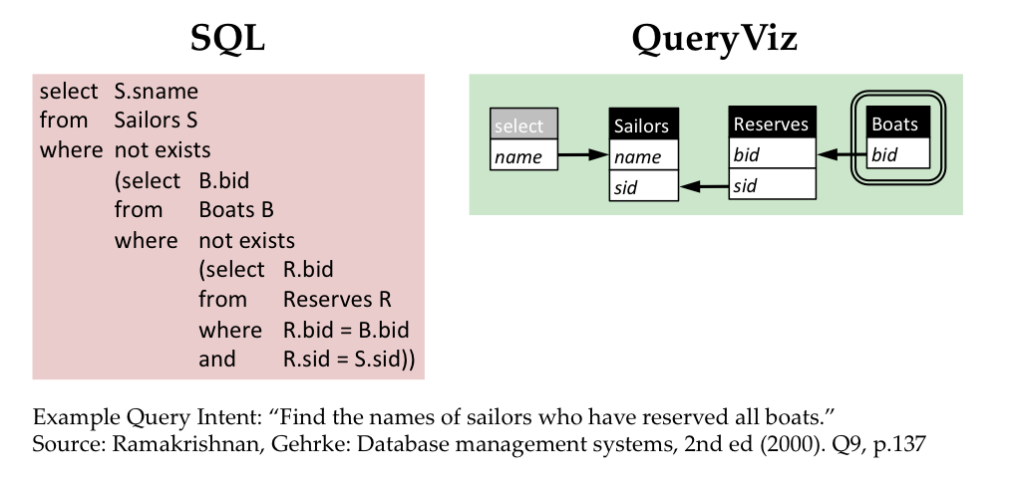
Queryvis.com

Slide 83
Breakout Qs
Choose a notetaker that as not been a notetaker in the past

Slide 84
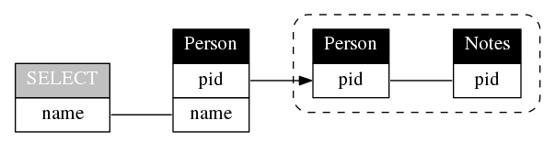
Breakout Qs
Choose a notetaker that as not been a notetaker in the past
SELECT name
FROM Person P
WHERE P.pid NOT IN (
SELECT P2.pid
FROM Person P2, Notes N
WHERE P2.pid = N.pid
)

Slide 85
Breakout Qs.
G1: Compare Hyper’s compilation vs MonetDB’s vectorization or Volcano. In what specific cases is one better and why?
G2: What logic makes sense to keep in C++ as opposed to LLVM? List some examples and why.
G3: How is query compilation tricky from a software engineering perspective? What could be done to improve this aspect?
Each group assigns notetaker to report back (1m)

Slide 86
Support your colleagues
for speaking up
A quick thanks or follow up
is great
https://en.wikipedia.org/wiki/Thumb_signal

Slide 87
Breakout Qs.
G1: Compare Hyper’s compilation vs MonetDB’s vectorization or Volcano. In what specific cases is one better and why?
G2: What logic makes sense to keep in C++ as opposed to LLVM? List some examples and why.
G3: How is query compilation tricky from a software engineering perspective? What could be done to improve this aspect?
Each group assigns notetaker to report back (1m)

Slide 88
Class 9
Cloud DBs

Slide 89

Turn video on, open chat, then click
Warmup discussion:
You’ve read industry and academic papers.
What do you feel are the strengths and weaknesses?

Slide 90
Logistics
A3 released
A5 is extra credit (optional)
Proposal comments sent via slack
Keeping existing lecture sequencing
was partly to time with Prof Vasiliki’s talk

Slide 91
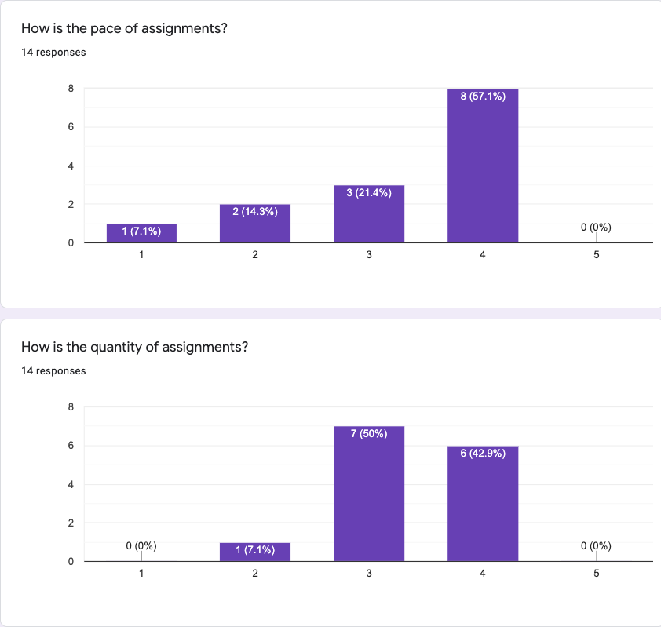
Comments
Almost Unrelenting
Go over assignment & concepts in class (x2)
More tests (x4)
Note: 5 late days

Slide 92
Breakout Qs.
G1: What are the similarities between Dremel/Snowflake and Gamma? What are the differences?
G2: Does in-situ processing really mean? For instance, does data not need to be loaded? What are its strengths and drawbacks?
G3: Speculate about future iterations software or hardware “disaggregation. How might it affect DBMS design?
Each group assigns notetaker to report back (1m)

Slide 93
Class 8
Column Stores

Slide 94
Turn video on, open chat, then click
Warmup discussion:
Which restaurant do you want to go most
when dine-in is safe again?

Slide 95
Logistics
Proposal due today 11:59PM EST
A2 due 10/4 11:59PM EST
A5 is now optional
Questions
Extend A3 and A4 by 1 week?
Swap Compilation/Udf topics with large scale dataflow?

Slide 96
Breakout Qs.
G1: What makes this paper well-written? Identify specific examples from the reading.
G2: Still assuming a ”big reads” workload, how would col-stores adapt to data distribution changes?
G3: Compare and contrast the in-memory vs on-disk “stores” in c-store to the design in a class RDBMS
Each group assigns notetaker to report back (1m)

Slide 97
Class 7
Query Optimizer

Slide 98
Turn video on, open chat
Warmup discussion:
Is a hot dog a sandwich?
3. Click when done

Slide 99
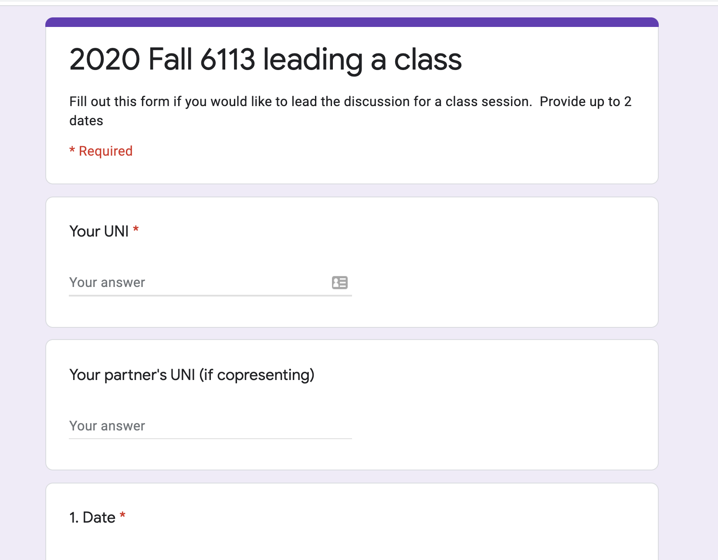
Logistics
Project proposals due 10/1
A2 due 10/4
Sign up to lead a class (TODAY)

Slide 100
DB seminar talks
9/29 Julia Stoyanovich (NYU)
Responsible Data Management
10/13 Wolfgang Gatterbauer (Northeastern)
QueryVis
10/20 Kostas Karanasos (Microsoft Gray Labs)
Lab overview + In-db ML inference
10/27 Vasiliki Kalavri (Boston U)
Streaming Research
11/10 Aaron Elmore (UChicago)
CrocodileDB
Zoom link in slack

Slide 101
Breakout Qs.
G1: Why is writing query optimizers harder than rocket science?
G2: Propose good methods to select promising transitions
G3: What are some benefits of volcano’s top-down search as compared to selinger’s algorithm? Hint: consider enforcers
G4: How to parallelize cascades? What challenges may arise?
Each group assigns notetaker to report back (1m)

Slide 102
Class 6

Slide 103
Do The Following
Turn video on
Type in chat or say:
Agree or disagree
Batman is a criminal
3. Click when done

Slide 104
Logistics
Project proposals due 10/1
A2 due 10/4
Sign up to lead a class (link on website, slack)

Slide 105
DB seminar talks
9/29 Julia Stoyanovich (NYU)
Responsible Data Management
10/13 Wolfgang Gatterbauer (Northeastern)
QueryVis
10/20 Kostas Karanasos (Microsoft Gray Labs)
Lab overview + In-db ML inference
10/27 Vasiliki Kalavri (Boston U)
Streaming Research
11/10 Aaron Elmore (UChicago)
CrocodileDB
Zoom link in slack

Slide 106
Breakout Qs. Provide specific examples
G1 Writing: What did the paper focus on & not focus on? Why?
G2 Contribs: What is the main contribution?
Design an example that highlights it against prior work.
G3 Exps: Based on the paper’s aims, what exps should they have run? Did they? If not, design a specific exp they should have run.
G4 Future: Describe a major follow up question to study.
Each group assigns notetaker to report back (1m)

Slide 107
Breakout
Discussion:
Discuss
Notetaker:
Summarize the discussion (~30s)

Slide 108
Class 5

Slide 109
Do The Following
Turn video on
Type in chat or say:
My favorite time of day is
___ ______
3. Click when done

Slide 110
Logistics
Today: multi-machine joins
A2 is out – optimizer!
A1 – what did you learn? What did you already know?

Slide 111
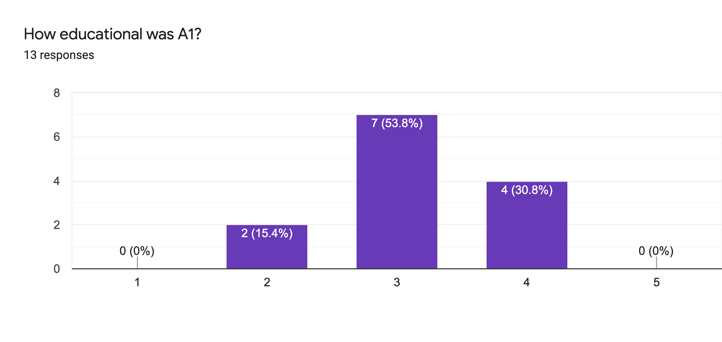
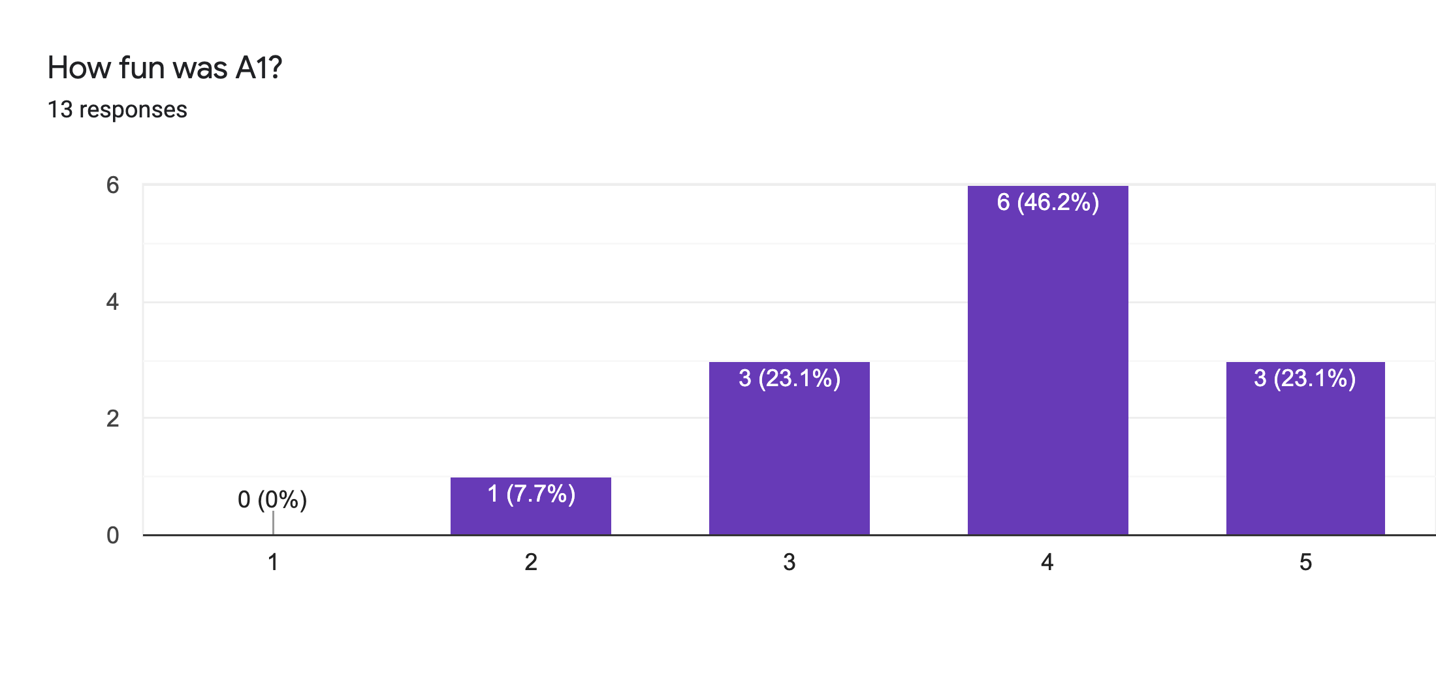
Main Comments
Vague Instructions
Bugs 🙏

Slide 112
Reviews
Strengths
Clear, honest writing
Ability to scale up/out is a big win!
Experiment design + explanation: A+

Slide 113
Reviews
Weaknesses
Lacks baselines
Aggregation?
Explain terms
How to choose partitioning key?
If scales to 1000+ nodes, what bottlenecks?
Failure on recovery?

Slide 114
Class 4

Slide 115
Do The Following
Turn video on
Type in chat or say:
A book/article I recently read
was ___ ______
3. Click when done

Slide 116

Today’s session
Finish previous class NO NEED!
Single Machine Joins.
Poll: paper reviews in pairs?

Slide 117
Today’s session
Finish previous class NO NEED!
Single Machine Joins.
Poll: paper reviews in pairs?
Poll: random pairing each week?

Slide 118
Breakout
Discussion:
Is a hot dog a sandwich? Discuss
Notetaker:
Summarize the discussion (~30s)

Slide 119
Discussion
Novelty
Theoretical guarantees
Experiment design

Slide 120
Class 3

Slide 121
Do The Following
Turn video on
Type in chat or say:
My favorite morning drink is ___ ___
(as much detail as you wish)
3. Click
Participants
Chat

Slide 122
Today’s session
Finish previous class
Multi-dimensional indexing
A1 is out, due 9/20

Slide 123
Breakout
Discussion:
Share your favorite quick cooking recipe,
or what you would like to cook
Notetaker:
Summarize the discussion (~30s)

Slide 124
Discussion
Novelty
Theoretical guarantees
Experiment design

Slide 125
Class 2

Slide 126
Turn video on,
enable mic & say:
“Hi, this is _(name)_,
I ate ___________ for breakfast”
Click when done
Participants
Chat

Slide 127
Logistics
Walk through
A0
Paper Reviews
Project list is up (still evolving)
Course goal
You feel comfortable reading papers + conducting research
Research ~ answering your own questions

Slide 128
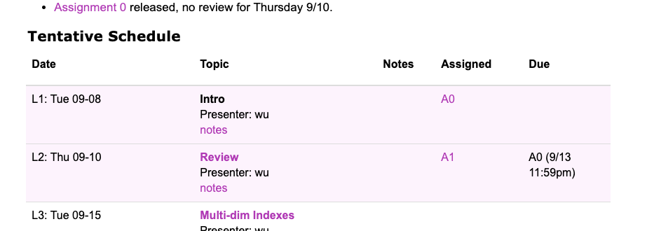
Today’s session
Finish previous class
Review classic DBMS components
Notes on w6113.github.io

Slide 129
#ScholarStrike
Notes:
Supposed to be a two day strike where you don’t do any professor related tasks and learn about BLM and challenges of underrepresented people, and what can be done to help

Slide 130
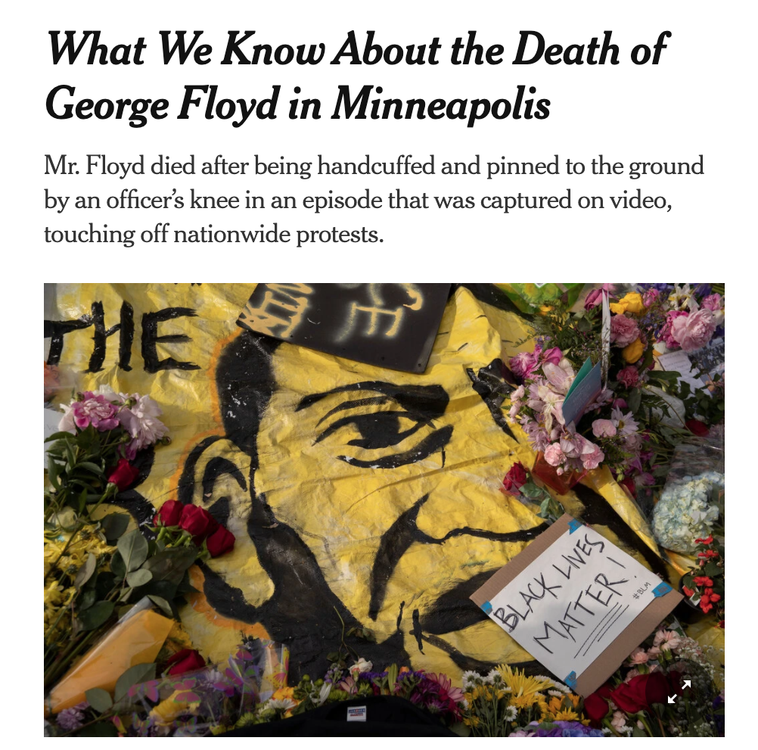
Black Lives Matter
Notes:
Discuss where all of this started and popularized this year, which, for me was the black lives matter protests.
BLM has been around for many years, but the very public, and unfair, murders of black people by police ignited the movement
For instance, geore floyd

Slide 131
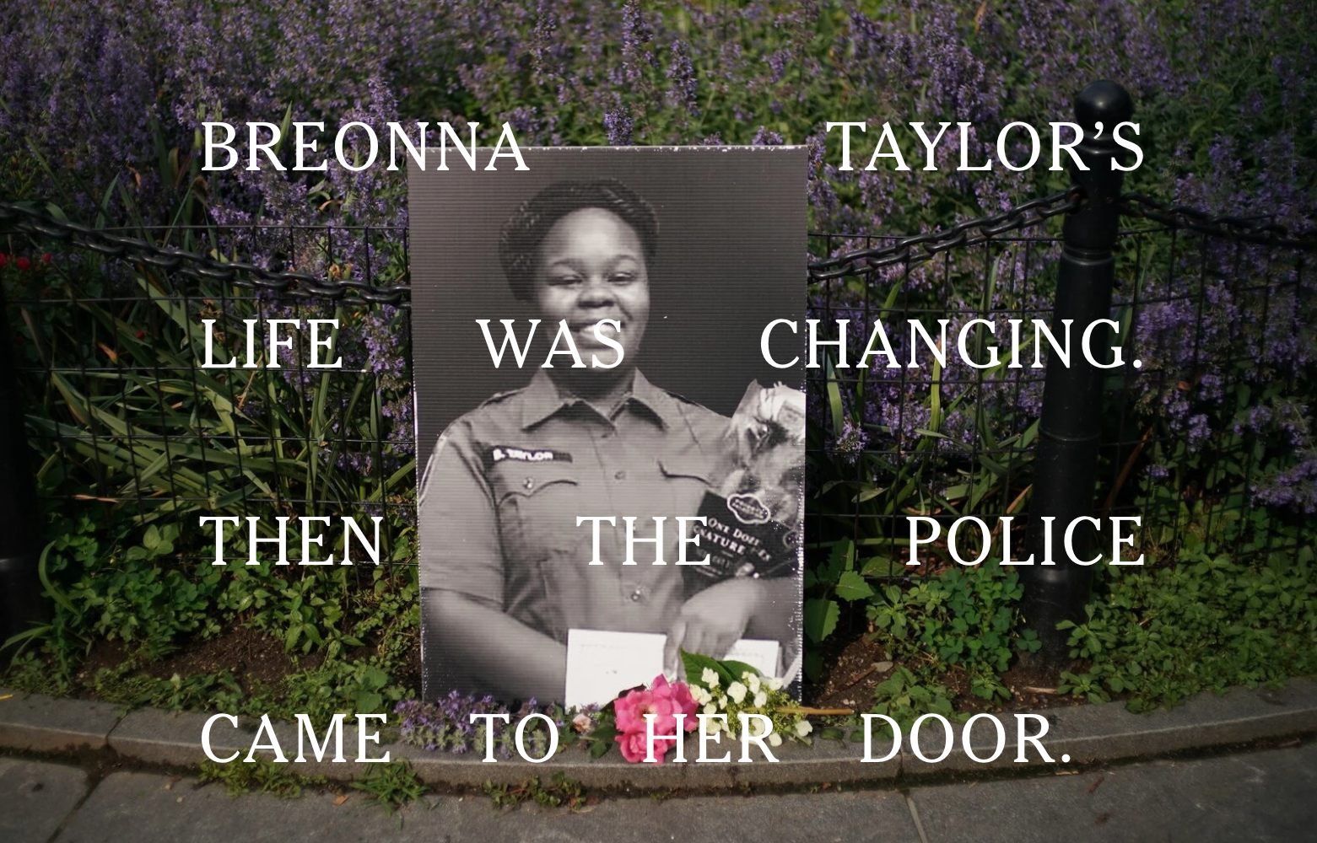
Black Lives Matter
Notes:
Breonna Taylor was a nurse just at home in her apartment

Slide 132

Black Lives Matter
Notes:
Linden Cameron was a 13 year old shot in the back

Slide 133

Black Lives Matter
Notes:
And Daniel Prude who was pinned and hooded by officers, who then blamed it on drug overdose, which leverages deep seated biases about black people.
These events are tragic, and simply symptoms of a deep disparity between African americans and the rest of America.
The US has historically treated immigrants of all kinds poorly, but African americans have been systematically oppressed from day one of the nation’s founding.
BLM is simply the manifestation of the outrage at this inequity

Slide 134
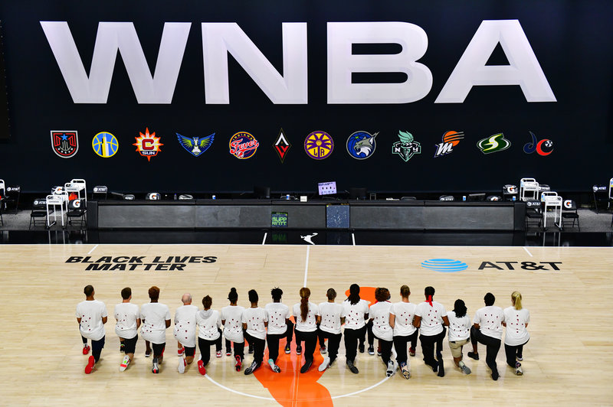
Notes:
Recently the WNBA led the sports world in going on a strike to further publicize this issue, and other sports leaguse followed.
ScholarStrike was a reaction by academics in support of this

Slide 135
Search terms to learn more
john oliver police
Netflix 13th
The case for reparations
shutdownstem
Notes:
Rather than cancel class, I’ll list here terms that are worth searching for to educate your self a bit about what’s going on. We will share these terms in the slack.
These are issues that I am not an expert in either, but I am happy to discuss these in recitation or OH.

Slide 136
Your Tasks for next class
Submit reviews for Tuesday
Submit Assignment 0 by 9/13 11:59PM EST
w6113.github.io

